Slide 1
K-D TREE

Slide 2
Example
Let's assume the following set of coords :
A[5, 4]
B[2, 9]
C[3, 5]
D[2, 2]
E[9, 2]
F[6, 1]
G[9, 9]

Slide 3
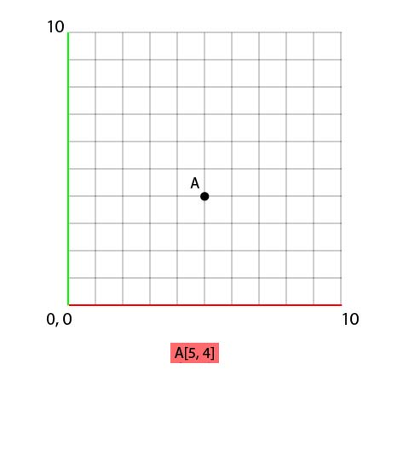
Example

Slide 4
Example
To set B, we'll compare his x value with the x value of A, like so :
B.x < A.x => 2 < 5

Slide 5
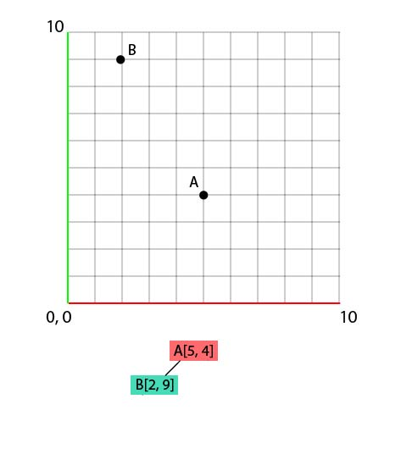
Example

Slide 6
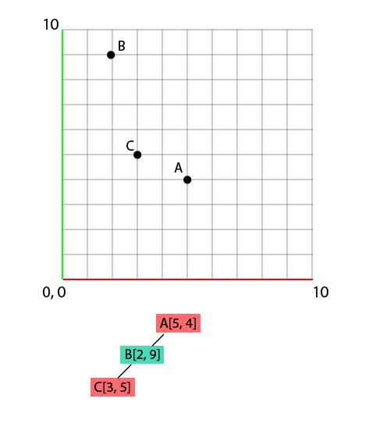
Example

Slide 7
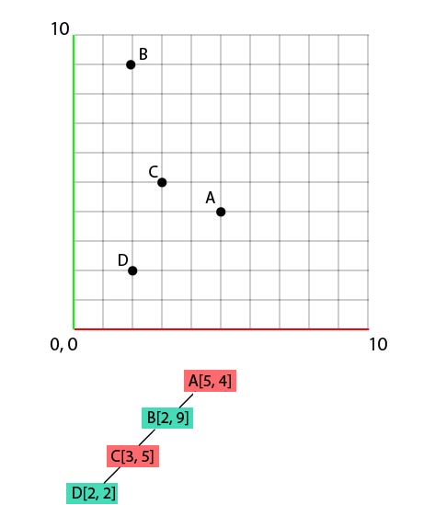
Example

Slide 8
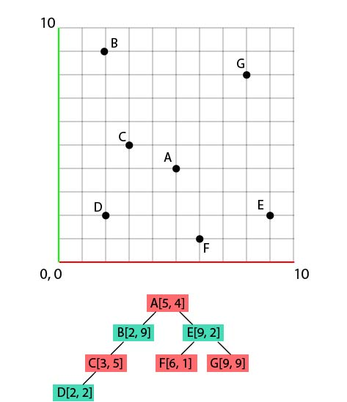
Example

Slide 9
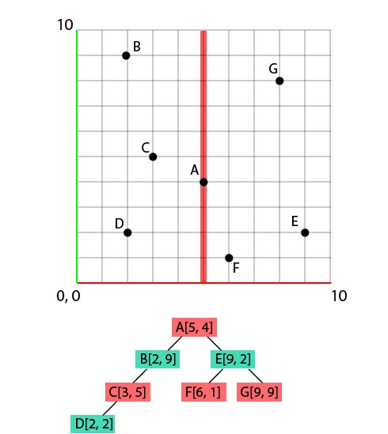
Example

Slide 10
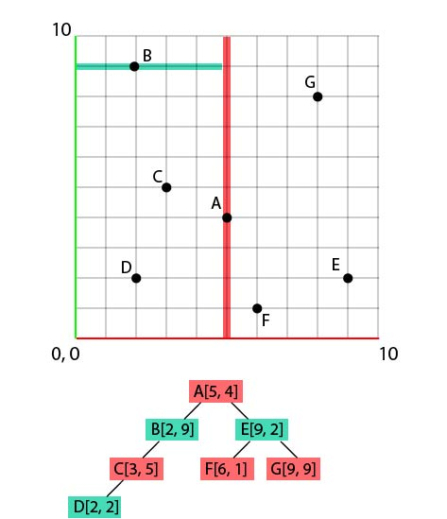
Example

Slide 11
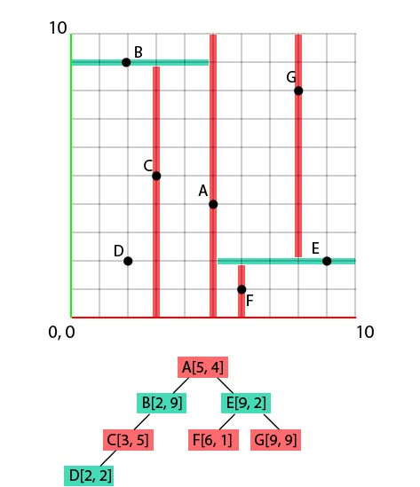
Example

